Slide 1
Edesia
Sprint Retrospective #6
Team Blue
Adam Bowers | Daniel Wingo | Stephen Bennett | Jonathan Holley
Github: aLotofAdam | 81wingo | stephenbennett2 | mccauley747
UNCG: ajbower3 | dtwingo | scbenne3 | jbholley

Slide 2
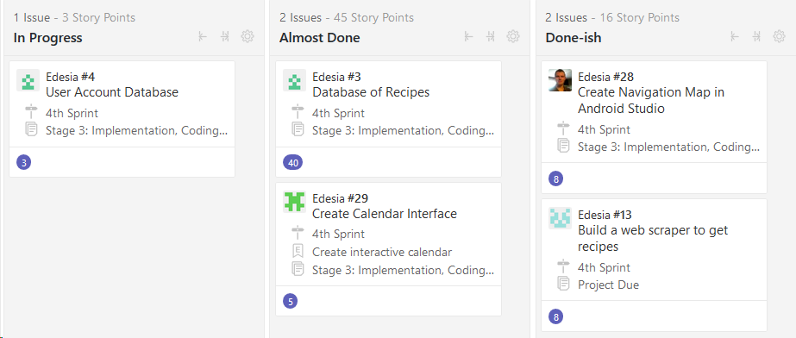
Last Sprint
Create Navigation Map
Create Database for Users and Recipes
Tune-up Web Scraper
Create Calendar Interface

Slide 3
Current Sprint
Navigation Components
Database
Web Scraper
Calendar UI

Slide 4
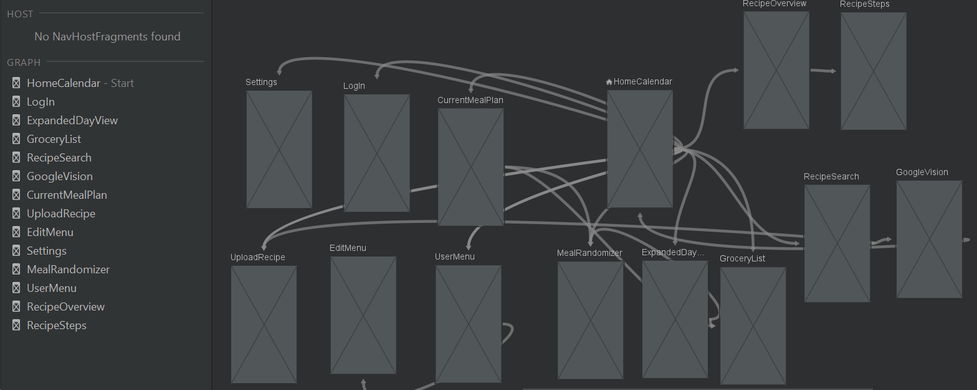
Navigation Map in Android Studio

Slide 5
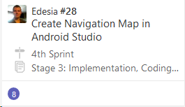
Navigation Components
Navigation
Host
Controller
Map
Activities
Fragments

Slide 6
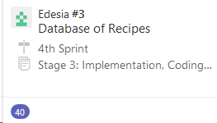
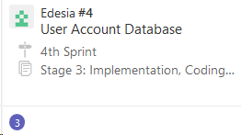
Database
Database created with user information and recipe
information being imported from CSV file currently.
Working with web scraper to possibly populate recipe
data directly from scraper.
Goal this week is to be fully functional with scraper
and begin to help with connections in middle layer.

Slide 7
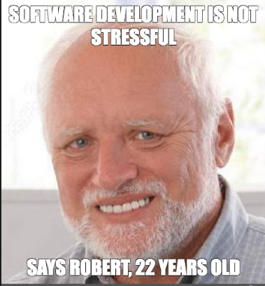
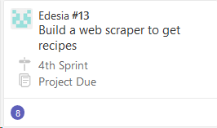
Web Scraper
Web scraper is build it pulls
URL, Recipe title,prep time, total time, ingredients, instructions
Working on sqlite storage and possible image
Next week plans are to populate the sqlite database and to start helping on the middle layer

Slide 8
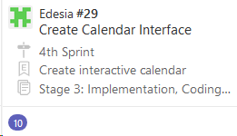
Calendar UI
Research
Implemented GUI
Research…
Planning Middle Layer
More Research…...

